Slide 1
FCE Part 1 Essay Writing

Slide 2




Structure
Introduction
-Advantages/positives
-Disadvantages/Negatives
Conclusion
Introduction
-1
-2
-3 (your own idea)
Conclusion
S
Either a 4 or 5 paragraph structure is fine.

Slide 3
Opinion Essay
Right so what if the question is something like
“ There is nothing we can do to save the environment. Do you agree?”
It wouldn't make much sense to talk about the advantages and disadvantages of saving the environment. It would be better to write an opinion Essay.

Slide 4
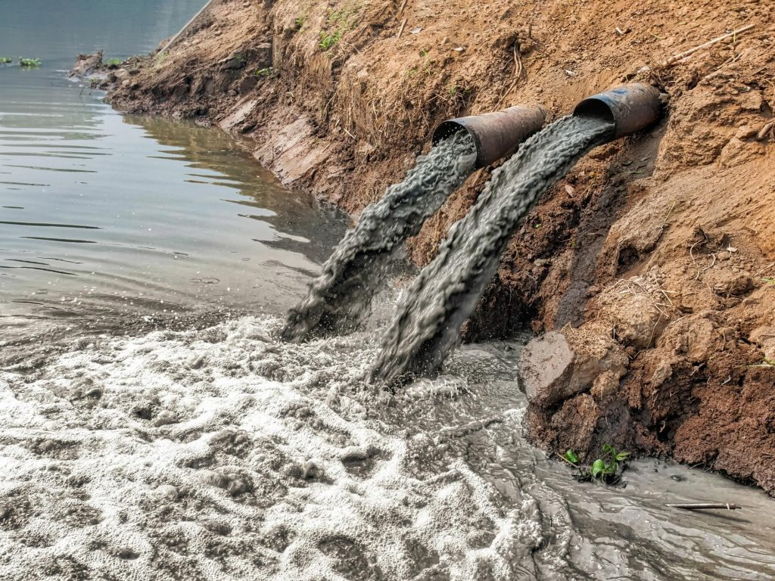

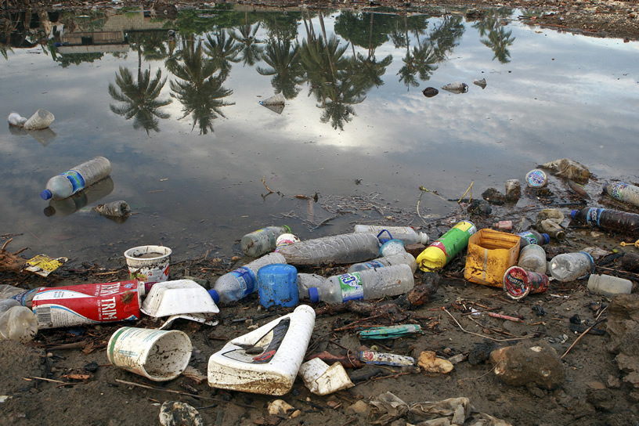
Pollution and the Environment
Transport
River and sea pollution
What type of pollution are we talking about in these pictures?
What is the effect on the planet?
What is the effect on people?
How can we solve these issues(problems)?

Slide 5
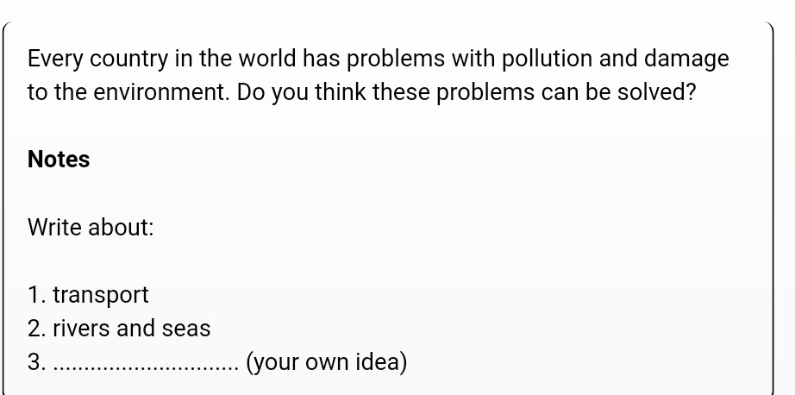
What kind of pollution does transport cause?
Air Pollution
Can you think of another way of saying ‘rivers and sea pollution’?
Water pollution
So we have some ideas for ‘transport’ and ‘river and sea pollution’. However, we need one more idea to talk about related to the environment.
Try to come up with some suggestions for a third idea.
Land pollution (e.g litter ->throwing rubbish in the streets)
Plastic pollution
Noise pollution

Slide 6
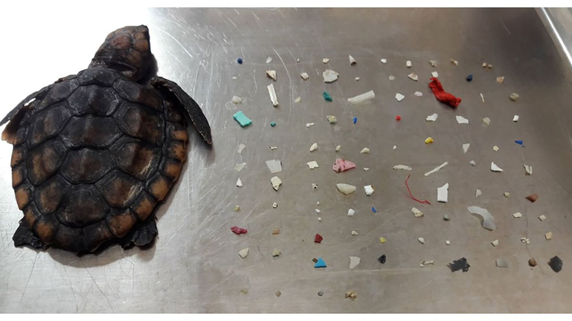
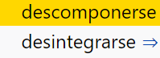

What is negative about these things?
It is ugly
It can destroy the habitat (homes) of plants and animals
Land pollution (e.g litter ->throwing rubbish in the streets)
It is different from other pollution because it does not decompose.
Animals mistake it for food
Plastic pollution
It is harmful to whales and dolphins because they use sound to survive.
Land animals also use sound to find food, attract a partner, avoid predators
Noise pollution

Slide 7
Introduction
There are people who claim that
others disagree. There is no doubt in my mind that
there is nothing we can do to save our planet
the problems our planet faces can be solved.

Slide 8
Body (Middle Paragraphs)
-First of all regarding (the idea).
For instance
In addition
We should also consider…..
..ing demonstrates the way…..
Moreover
Let us not forget …..
For example
Furthermore
Introduce the first idea
Give an example
Add one more piece of information
Introduce 2nd idea
Give an example
Add one more piece of information
Introduce the 3rd idea
Give an example
Add one more piece of information

Slide 9
This sentence is sometimes difficult to write so let’s practise.
..ing demonstrates the way…..
If we recycle we can stop plastic pollution and help animals.
Recycling demonstrates the way we can stop plastic pollution and help animals.
If we make less noise, birds will be able to sing and communicate better
Making less noise demonstrates the way we can help birds communicate.

Slide 10
Conclusion
To sum up on the basis of the arguments I have presented.It is my firm belief that (+1 more sentence summarizing your main argument, use different vocabulary here)
To sum up on the basis of the arguments I have presented. It is my firm belief that
not only can we save our planet, but we can make it better and a much healthier, happier place to live in.

Slide 11
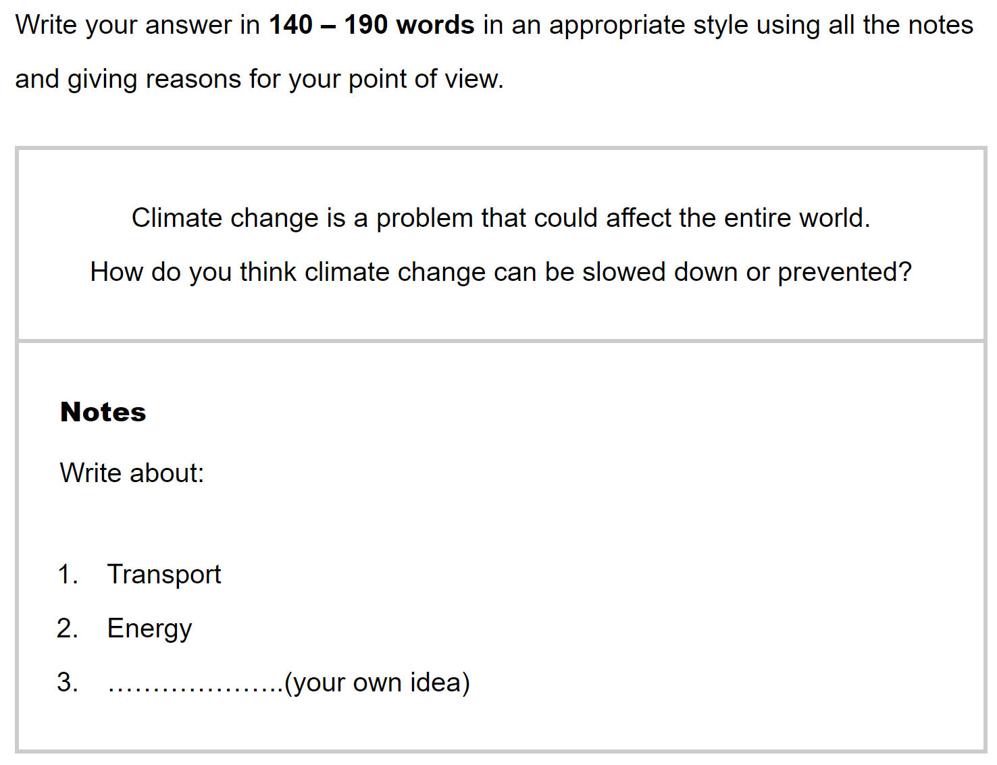


Slide 12
Finally
Try to stay within the word limit, but dont stress if you have gone over by a sentence.
NO CONTRACTIONS ( haven’t, I’d, wouldn’t...etc)
try to avoid “lots of” instead think of “much” or “many”
Avoid repetition where ever possible, How many different ways can you think of to say student?
Think about using the passive to avoid repeating the subject.
Pupils, Students, People, Child
People have to pay more attention to…..(active)
More attention needs to be paid to ……(passive eliminating the subject)

Slide 13
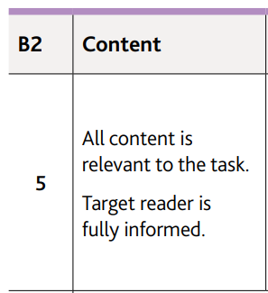
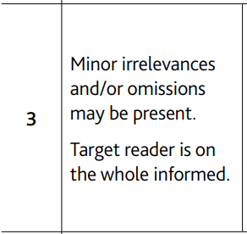
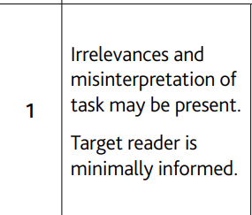
You did everything they asked you to do. You mentioned the 2 ideas, You invented a 3rd idea. You gave examples of the problems and possible solutions.
You have some things that are not relevant. Or maybe you forgot to
mention the 3rd point
give examples
Mention any solutions
Lots of things irrelevant, maybe you didn’t understand the question and wrote about something else.

Slide 14
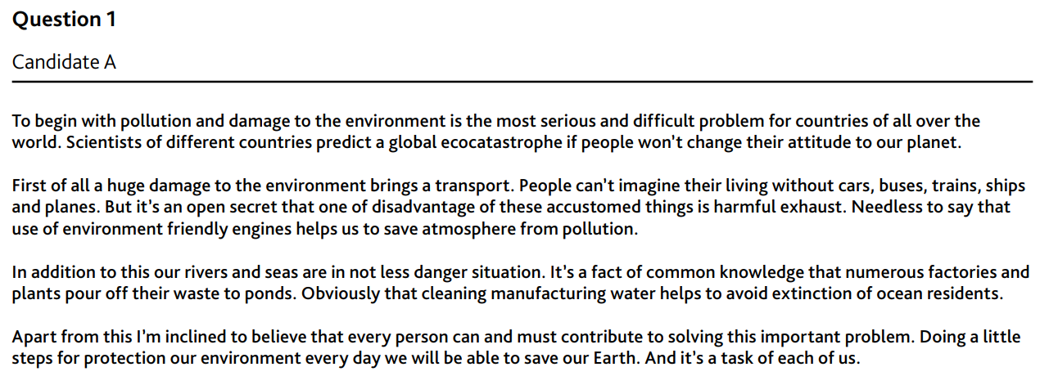
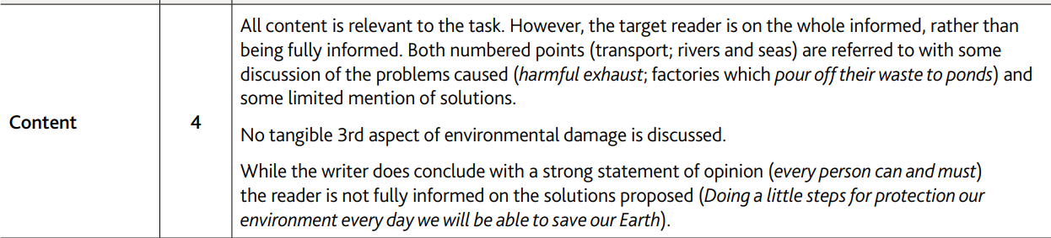
Give this candidate a score for content

Slide 15
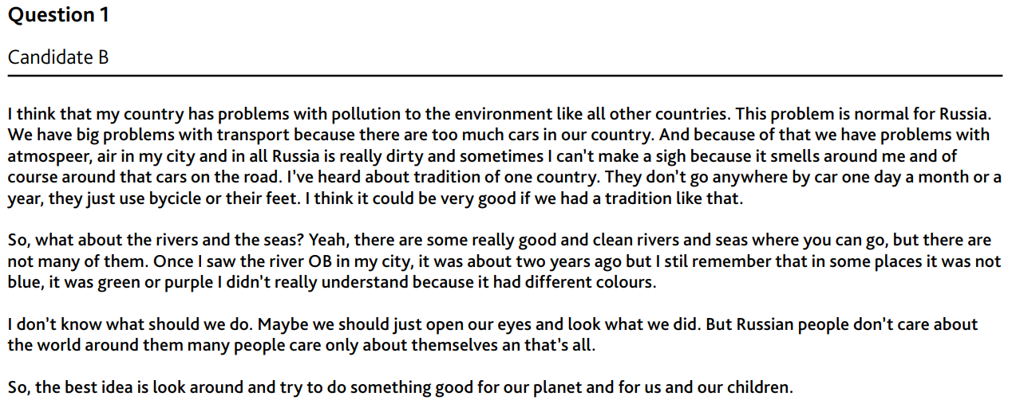
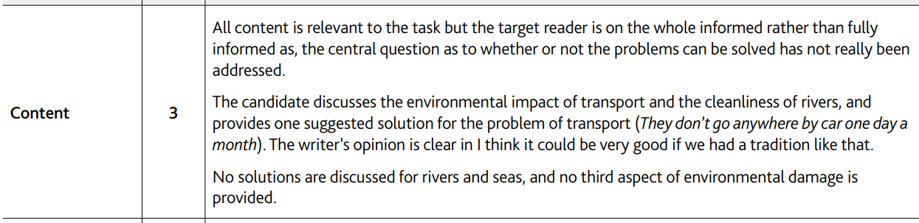
Give this candidate a score for content

